Slide 1
CHAPTER 3
Lexical and Syntax Analysis

Slide 2
CHAPTER 4 TOPICS
Introduction
Lexical Analysis
The Parsing Problem
Recursive-Descent Parsing
Bottom-Up Parsing
1-<number>

Slide 3
4.1 INTRODUCTION
Language implementation systems must analyze source code, regardless of the specific implementation approach (Compilation, Pure interpretation and JIT)
Nearly all syntax analysis is based on a formal description of the syntax of the source language (BNF)
1-<number>

Slide 4
SYNTAX ANALYSIS
The syntax analysis portion of a language processor nearly always consists of two parts:
  A low-level part called a lexical analyzer (mathematically, a finite automaton based on a regular grammar)
  A high-level part called a syntax analyzer, or parser (mathematically, a push-down automaton based on a context-free grammar, or BNF)
1-<number>

Slide 5
USING BNF TO DESCRIBE SYNTAX
Provides a clear and concise syntax description – contex free, can be used by human and softwares
The parser (syntax analyzer) can be based directly on the BNF
Parsers based on BNF are easy to maintain - modularity
1-<number>

Slide 6
REASONS TO SEPARATE LEXICAL AND SYNTAX ANALYSIS
Simplicity - less complex approaches can be used for lexical analysis; separating them simplifies the parser
Efficiency - separation allows optimization of the lexical analyzer
Portability - parts of the lexical analyzer may not be portable, but the parser always is portable
1-<number>

Slide 7
4.2 LEXICAL ANALYSIS
A lexical analyzer is a pattern matcher for character strings
A lexical analyzer is a “front-end” for the parser
Identifies substrings of the source program that belong together - lexemes
  Lexemes match a character pattern, which is associated with a lexical category called a token
  sum is a lexeme; its token may be IDENT
1-<number>

Slide 8
LEXICAL ANALYSIS (CONTINUED)
The lexical analyzer
  Extracts lexemes from given input string and produce corresponding tokens
  Syntax analyzer will only see the output of lexical analyzer (one lexeme at a time)
  Skips comments and blanks
  Inserts lexemes for user-defined names into symbol table – used by compiler
  Detects syntactical errors in tokens
1-<number>

Slide 9
LEXICAL ANALYSIS (CONTINUED)
The lexical analyzer is usually a function that is called by the parser when it needs the next token
Three approaches to building a lexical analyzer:
  Write a formal description of the tokens and use a software tool that constructs table-driven lexical analyzers given such a description
  Design a state diagram that describes the tokens and write a program that implements the state diagram
  Design a state diagram that describes the tokens and hand-construct a table-driven implementation of the state diagram
1-<number>

Slide 10
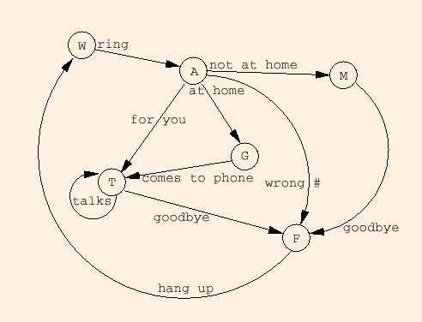
EXAMPLE OF A STATE DIAGRAM
1-<number>

Slide 11
STATE DIAGRAM DESIGN
  A naïve state diagram would have a transition from every state on every character in the source language - such a diagram would be very large!
1-<number>

Slide 12
LEXICAL ANALYSIS (CONT.)
In many cases, transitions can be combined to simplify the state diagram
  When recognizing an identifier, all uppercase and lowercase letters are equivalent
    Use a character class that includes all letters
  When recognizing an integer literal, all digits are equivalent - use a digit class
1-<number>

Slide 13
LEXICAL ANALYSIS (CONT.)
Reserved words and identifiers can be recognized together (rather than having a part of the diagram for each reserved word)
  Use a table lookup to determine whether a possible identifier is in fact a reserved word
1-<number>

Slide 14
LEXICAL ANALYSIS (CONT.)
Convenient utility subprograms:
  getChar - gets the next character of input, puts it in nextChar, determines its class and puts the class in charClass
  addChar - puts the character from nextChar into the place the lexeme is being accumulated, lexeme
  lookup - determines whether the string in lexeme is a reserved word (returns a code)
1-<number>

Slide 15
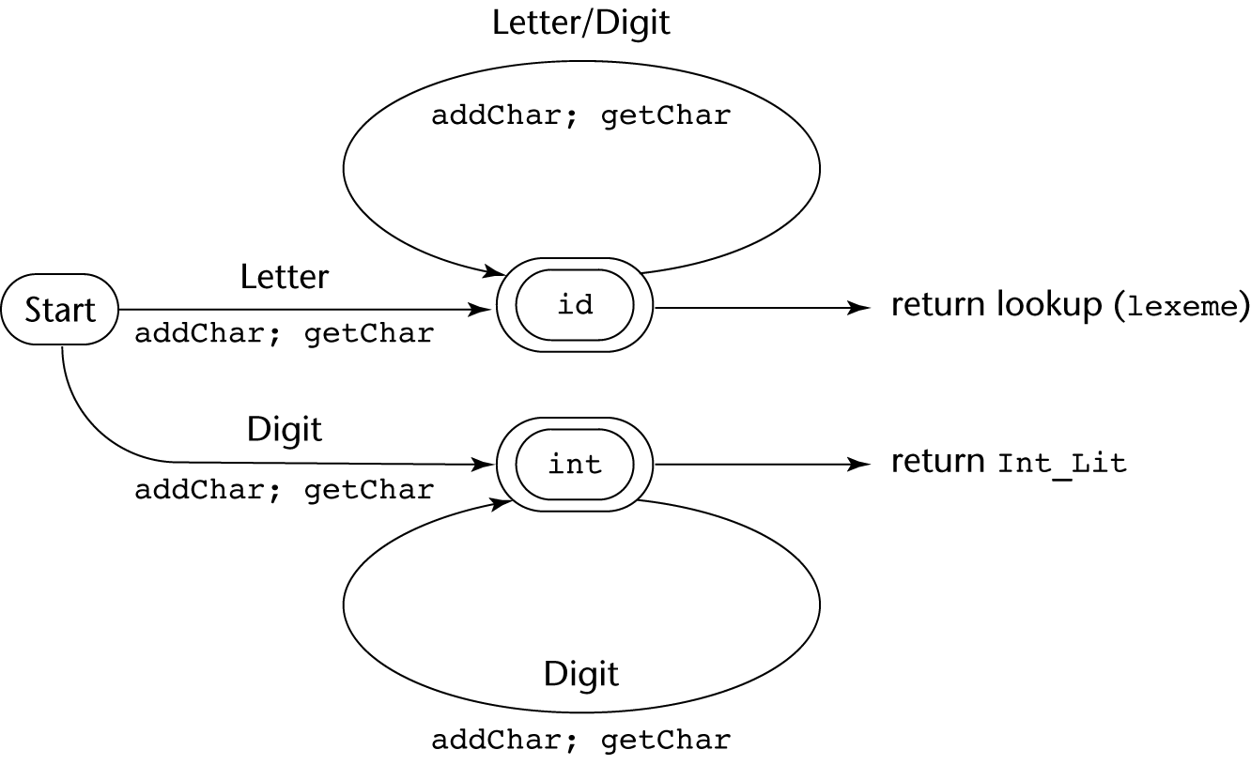
STATE DIAGRAM
1-<number>

Slide 16
Implementation (assume initialization):
int lex() {
getChar();
switch (charClass) {
case LETTER:
addChar();
getChar();
while (charClass == LETTER || charClass == DIGIT)
{
addChar();
getChar();
}
return lookup(lexeme);
break;
case DIGIT:
addChar();
getChar();
while (charClass == DIGIT) {
addChar();
getChar();
}
return INT_LIT;
break;
} /* End of switch */
} /* End of function lex */

Slide 17
PARSING
Goals of the parser, given an input program:
  Find all syntax errors; for each, produce an appropriate diagnostic message, and recover quickly
  Produce the parse tree, or at least a trace of the parse tree, for the program
1-<number>

Slide 18
PARSING (CONT.)
Notations used …
  Lowercase letters at the beginning of the alphabet (a, b, …) for terminal symbols.
  Uppercase letters at the beginning of the alphabet (A, B, …) for nonterminals symbols.
  Uppercase letters at the end of the alphabet (W, X, Y, Z) for terminals or nonterminals.
  Lowercase letters at the end of the alphabet (w, x, y, z) for strings of terminal.
  Lowercase Greek letters (α, β, γ, δ) for mixed strings (terminals and/or nonterminals)
1-<number>

Slide 19
PARSING (CONT.)
Two categories of parsers
  Top down - produce the parse tree, beginning at the root
    Order is that of a leftmost derivation
    Traces or builds the parse tree in preorder
  Bottom up - produce the parse tree, beginning at the leaves
    Order is that of the reverse of a rightmost derivation
Parsers look only one token ahead in the input
1-<number>

Slide 20
PARSING (CONT.)
Top-down Parsers
  Given a sentential form, xAα , the parser must choose the correct A-rule to get the next sentential form in the leftmost derivation, using only the first token produced by A
The most common top-down parsing algorithms:
  Recursive descent - a coded implementation
  LL parsers - table driven implementation
A
bB
cbB
a
1-<number>

Slide 21
THE PARSING PROBLEM (CONT.)
Bottom-up parsers
  Given a right sentential form, α, determine what substring of α is the right-hand side of the rule in the grammar that must be reduced to produce the previous sentential form in the right derivation
  The most common bottom-up parsing algorithms are in the LR family
  Eg.
    S → aAc
    A → aA | b
    S => aAc => aaAc => aabc
1-<number>

Slide 22
THE PARSING PROBLEM (CONT.)
The Complexity of Parsing
  Parsers that work for any unambiguous grammar are complex and inefficient ( O(n³), where n is the length of the input )
  Compilers use parsers that only work for a subset of all unambiguous grammars, but do it in linear time ( O(n), where n is the length of the input )
1-<number>

Slide 23
RECURSIVE-DESCENT PARSING
There is a subprogram for each nonterminal in the grammar, which can parse sentences that can be generated by that nonterminal
EBNF is ideally suited for being the basis for a recursive-descent parser, because EBNF minimizes the number of nonterminals
1-<number>

Slide 24
RECURSIVE-DESCENT PARSING (CONT.)
A grammar for simple expressions:
<expr> → <term> {(+ | -) <term>}
<term> → <factor> {(* | /) <factor>}
<factor> → id | ( <expr> )
1-<number>

Slide 25
RECURSIVE-DESCENT PARSING (CONT.)
Assume we have a lexical analyzer named lex, which puts the next token code in nextToken
The coding process when there is only one RHS:
  For each terminal symbol in the RHS, compare it with the next input token; if they match, continue, else there is an error
  For each nonterminal symbol in the RHS, call its associated parsing subprogram
1-<number>

Slide 26
RECURSIVE-DESCENT PARSING (CONT.)
void expr() {
term();
while (nextToken == PLUS_CODE || nextToken == MINUS_CODE){
lex();
term();
}
}
void term(){
factor();
while (nextToken == AST_CODE || nextToken == SLACH_CODE){
lex();
factor();
}
}
void factor() {
if (nextToken) == ID_CODE)
lex();
else if (nextToken == LEFT_PAREN_CODE) {
lex();
expr();
if (nextToken == RIGHT_PAREN_CODE)
lex();
else
error();
} /* End of else if (nextToken == ... */
else error(); /* Neither RHS matches */
}
<expr> → <term> {(+ | -) <term>}
<term> → <factor> {(* | /) <factor>}
<factor> → id | ( <expr> )
1-<number>

Slide 27
RECURSIVE-DESCENT PARSING (CONT.)
/* Function expr
Parses strings in the language generated by the rule:
<expr> → <term> {(+ | -) <term>}
*/
void expr() {
/* Parse the first term */
term();
/* As long as the next token is + or -, call lex to get the next token, and parse the next term */
while (nextToken == PLUS_CODE || nextToken == MINUS_CODE){
lex();
term();
}
}
This particular routine does not detect errors
Convention: Every parsing routine leaves the next token in nextToken
1-<number>

Slide 28
RECURSIVE-DESCENT PARSING (CONT.)
/* Function term
Parses string in the language generated by the rule: <term> -> <factor> {(*|/)<factor>}*/
void term(){
/*parse the first factor */
factor();
/*As long as the next token is * or /, call lex to get the next token, and parse the next facrtor*/
while (nextToken == AST_CODE || nextToken == SLACH_CODE){
lex();
factor();
}
}
1-<number>

Slide 29
RECURSIVE-DESCENT PARSING (CONT.)
A nonterminal that has more than one RHS requires an initial process to determine which RHS it is to parse
  The correct RHS is chosen on the basis of the next token of input (the lookahead)
  The next token is compared with the first token that can be generated by each RHS until a match is found
  If no match is found, it is a syntax error
1-<number>

Slide 30
RECURSIVE-DESCENT PARSING (CONT.)
/* Function factor
Parses strings in the language generated by the rule:
<factor> -> id | (<expr>) */
void factor() { /* Determine which RHS */
if (nextToken) == ID_CODE) /* For the RHS id, just call lex */
lex();
/* If the RHS is (<expr>) – call lex to pass over the left parenthesis, call expr, and check for the right parenthesis */
else if (nextToken == LEFT_PAREN_CODE) {
lex();
expr();
if (nextToken == RIGHT_PAREN_CODE)
lex();
else
error();
} /* End of else if (nextToken == ... */
else error(); /* Neither RHS matches */
}
1-<number>

Slide 31
RECURSIVE-DESCENT PARSING (CONT.)
The LL Grammar Class
  The Left Recursion Problem
    If a grammar has left recursion, either direct or indirect, it cannot be the basis for a top-down parser
      A grammar can be modified to remove left recursion
      Direct
      A → A + B………….
      Indirect
      A → B a A
      B → A b
1-<number>

Slide 32
RECURSIVE-DESCENT PARSING (CONT.)
The LL Grammar Class
  The Left Recursion Problem
    If a grammar has left recursion, either direct or indirect, it cannot be the basis for a top-down parser
      A grammar can be modified to remove left recursion
      A → Aα |β left recursion rule
      Sol:
      A → βA’
      A’ → αA’| ε ε is the null value
1-<number>

Slide 33
RECURSIVE-DESCENT PARSING (CONT.)
The LL Grammar Class
  The Left Recursion Problem
E → E + T| T
T→ T * F | F
F → (E) | id
E → T E’
E’ → + T E’|ε ε is the null value
T→ F T’
T’ → * F T’| ε
F → (E) id
      A → Aα |β
      A → βA’
      A’ → αA’| ε
1-<number>

Slide 34
RECURSIVE-DESCENT PARSING (CONT.)
The other characteristic of grammars that disallows top-down parsing is the lack of pairwise disjointness
  The inability to determine the correct RHS on the basis of one token of lookahead
  Def: FIRST(α) = {a | α =>* aβ }
(If α =>* ε, ε is in FIRST(α))
1-<number>

Slide 35
RECURSIVE-DESCENT PARSING (CONT.)
Pairwise Disjointness Test:
  For each nonterminal, A, in the grammar that has more than one RHS, for each pair of rules, A → α_{i} and A → α_{j}, it must be true that
FIRST(α_{i}) ∩ FIRST(α_{j}) = φ
Examples:
A → aA | bB - pass the test
    A → aA | aB - fail the test
    SOL:
A → aA’
A’ → A|B
    A → aA | a - fail the test
    SOL:
A → aA’
A’ → A| ε ε is the null value
1-<number>

Slide 36
RECURSIVE-DESCENT PARSING (CONT.)
Left factoring can resolve the problem
Replace
<variable> → identifier | identifier [<expression>]
with
<variable> → identifier <new>
<new> → ε | [<expression>]
or
<variable> → identifier [[<expression>]]
(the outer brackets are metasymbols of EBNF)
1-<number>

Slide 37
RECURSIVE-DESCENT PARSING (CONT.)
Left factoring can resolve the problem
s →a|ab|abc|abcd
Sol:
s → as’
s’ → ε|bs’’ ε is the null value
s’’ → ε|cs’’’
s’’’ → ε|d
1-<number>

Slide 38
BOTTOM-UP PARSING
The parsing problem is finding the correct RHS in a right-sentential form (handle) to reduce to get the previous right-sentential form in the derivation
Example grammar:
  E → E + T | T
  T → T * F | F
  F → ( E ) | id (1)
  E.g. derived sentence: id + id * id
1-<number>

Slide 39
BOTTOM-UP PARSING (CONT.)
Intuition about handles:
  Def: β is the handle of the right sentential form
γ = αβw if and only if S =>*_{rm} αAw =>_{rm} αβw
  Def: β is a phrase of the right sentential form
γ if and only if S =>* γ = α₁Aα₂ =>+ α₁βα₂
  Def: β is a simple phrase of the right sentential form γ if and only if S =>* γ = α₁Aα₂ => α₁βα₂
1-<number>

Slide 40
BOTTOM-UP PARSING (CONT.)
Intuition about handles:
  The handle of a right sentential form is its leftmost simple phrase
  Given a parse tree, it is now easy to find the handle
  Parsing can be thought of as handle pruning
1-<number>

Slide 41
BOTTOM-UP PARSING (CONT.)
Shift-Reduce Algorithms
  Reduce is the action of replacing the handle on the top of the parse stack with its corresponding LHS
  Shift is the action of moving the next token to the top of the parse stack
1-<number>

Slide 42
BOTTOM-UP PARSING (CONT.)
Advantages of LR parsers:
  They will work for nearly all grammars that describe programming languages.
  They work on a larger class of grammars than other bottom-up algorithms, but are as efficient as any other bottom-up parser.
  They can detect syntax errors as soon as it is possible.
  The LR class of grammars is a superset of the class parsable by LL parsers.
1-<number>

Slide 43
BOTTOM-UP PARSING (CONT.)
LR parsers must be constructed with a tool
Knuth’s insight: A bottom-up parser could use the entire history of the parse, up to the current point, to make parsing decisions
  There were only a finite and relatively small number of different parse situations that could have occurred, so the history could be stored in a parser state, and stored in the parse stack
1-<number>

Slide 44
BOTTOM-UP PARSING (CONT.)
An LR configuration stores the state of an LR parser
  (S₀X₁S₁X₂S₂…X_{m}S_{m}, a_{i}a_{i}+1…a_{n}$)
1-<number>

Slide 45
BOTTOM-UP PARSING (CONT.)
LR parsers are table driven, where the table has two components, an ACTION table and a GOTO table
  The ACTION table specifies the action of the parser, given the parser state and the next token
    Rows are state names; columns are terminals
  The GOTO table specifies which state to put on top of the parse stack after a reduction action is done
    Rows are state names; columns are nonterminals
1-<number>

Slide 46

STRUCTURE OF AN LR PARSER
1-<number>

Slide 47
BOTTOM-UP PARSING (CONT.)
Initial configuration: (S₀, a₁…a_{n}$)
Parser actions:
  If ACTION[S_{m}, a_{i}] = Shift S, the next configuration is:
  (S₀X₁S₁X₂S₂…X_{m}S_{m}a_{i}S, a_{i+1}…a_{n}$)
  If ACTION[S_{m}, a_{i}] = Reduce A → β and S = GOTO[S_{m-r}, A], where r = the length of β, the next configuration is
    (S₀X₁S₁X₂S₂…X_{m-r}S_{m-r}AS, a_{i}a_{i+1}…a_{n}$)
1-<number>

Slide 48
BOTTOM-UP PARSING (CONT.)
Parser actions (continued):
  If ACTION[S_{m}, a_{i}] = Accept, the parse is complete and no errors were found.
  If ACTION[S_{m}, a_{i}] = Error, the parser calls an error-handling routine.
1-<number>

Slide 49
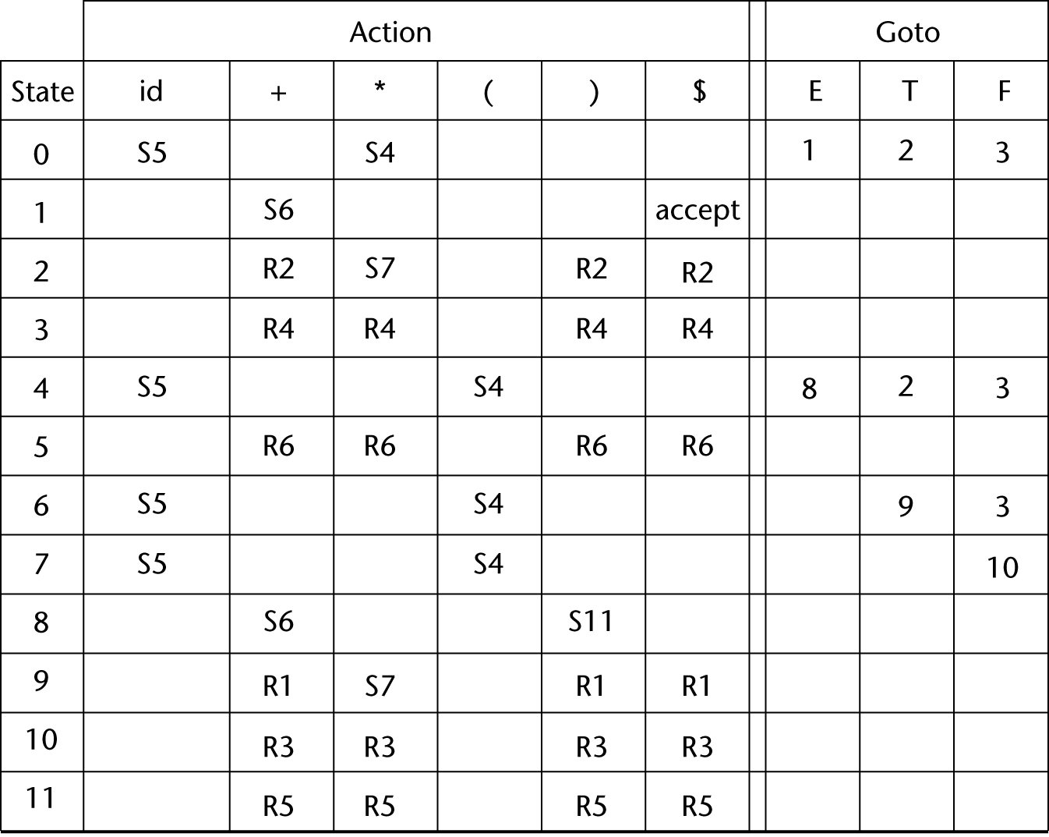
LR PARSING TABLE
S4
1-<number>

Slide 50
BOTTOM-UP PARSING (CONT.)
Grammar (1) rewritten and numbered for easy referencing in a parsing table.
  E → E + T
  E → T
  T → T * F
  T → F
  F → ( E )
  F → id
1-<number>

Slide 51
BOTTOM-UP PARSING (CONT.)
Stack | Input | Action
0 | id + id * id $ | Shift 5
0id5 | + id * id $ | Reduce 6 (use GOTO[0, F])
0F3 | + id * id $ | Reduce 4 (use GOTO[0, T])
0T2 | + id * id $ | Reduce 2 (use GOTO[0, E])
0E1 | + id * id $ | Shift 6
0E1+6 | id * id $ | Shift 5
0E1+6id5 | * id $ | Reduce 6 (use GOTO[6, F])
0E1+6F3 | * id $ | Reduce 4 (use GOTO[6, T])
0E1+6T9 | * id $ | Shift 7
0E1+6T9*7 | id $ | Shift 5
0E1+6T9*7id5 | $ | Reduce 6 (use GOTO[7, F])
0E1+6T9*7F10 | $ | Reduce 3 (use GOTO[6, T])
0E1+6T9 | $ | Reduce 1 (use GOTO[0, E])
0E1 | $ | Accept
1-<number>

Slide 52
BOTTOM-UP PARSING (CONT.)
A parser table can be generated from a given grammar with a tool, e.g., yacc
1-<number>

Slide 53
SUMMARY
Syntax analysis is a common part of language implementation
A lexical analyzer is a pattern matcher that isolates small-scale parts of a program
  Detects syntax errors
  Produces a parse tree
A recursive-descent parser is an LL parser
  EBNF
Parsing problem for bottom-up parsers: find the substring of current sentential form
The LR family of shift-reduce parsers is the most common bottom-up parsing approach
1-<number>

